Slide 1
ESA Rulemaking Parent Forum #2
November 18, 2021

Slide 2
State Board Staff Introductions
Catcher Baden, Deputy Director
Katherine Ruiz, ESA Project Director

Slide 3
Agenda
State Board Introductions
Who is the State Board of Education?
State Board of Education vs. Department of Education
House Bill 2898 changes to ESA
State Board of Education Rulemaking Process
What is in the Rule?
What is not in the Rule?
Considerations for the Legislature
Next Steps
Questions & Discussion

Slide 4
Who is the State Board of Education?
Constitutional Board, made up of 11 members: 10 members are appointed by the Governor and confirmed by the Senate, one member is elected (Superintendent)
Purpose: General supervision over the conduct of public school system (Title 15)
Adopt rules and policies to accomplish this purpose
Adopt graduation requirements
Supervise and control the certification of educators, including discipline of unprofessional/immoral conduct
Adopt statewide proficiency assessments, passing scores, and methods of administering assessments
Investigate allegations of immoral and unprofessional conduct
Receive ESA Appeals, ESA rules, and refer ESA Accounts to the Attorney General’s Office for collections and fraud

Slide 5
State Board of Education vs. Department of Education
State Board of Education is the policy arm.
Staff: 19 FTEs
Policy: Administrative Rules and State Board policies
I.E.: Certification Rules vs. School Accountability Policy
Department of Education is the administrative arm.
Staff: 600+ FTEs
Administration: Day to Day operations
I.E.: Certification Desk and School Accountability Unit

Slide 6
What are House Bill 2898 Changes?
Pursuant to the House Bill 2898:
Exempts State Board from using OAH, and accompanying statutes, for Appeal Hearings
Modifies eligibility requirements as follows:
Exempts children from the public school enrollment requirement if they qualify for free and reduced-price lunch and attended a D or F school or school district or are eligible to attend kindergarten and reside within the attendance boundaries of a D or F school;
Reduces the public school enrollment requirement from the first 100 days of the prior fiscal year to 45 days of the current or prior fiscal year; and
Requires kindergarten students enrolled in AOI to log 200 hours of instruction to be eligible.
Allows ESA funds to be used towards educational therapies, including amounts not covered by insurance.
Requires ADE enroll and issue award letters for ESA Applications within 30 days; rather than 45 days.
Except for in cases of fraud, requires repaid expense to be credited back to the child’s ESA rather than the general fund.
Prohibits ADE from withholding funding or contract renewal from a parent if the Board has granted a stay request in response to an appeal.

Slide 7
What is the State Board’s rulemaking process?
Administrative Rule Process:
Host a Live meeting with interested stakeholders to review conforming changes per House Bill 2898
Submit draft of rules to the State Board of Education to “open” (starts the formal rule making process)
Hold a public hearing (opportunity for the public to speak on the open rules)
Update the Board on the open rules at a second Board meeting
Hold additional public forums and hearings as needed
Bring the open rule draft to the third Board meeting for the Board to “close” the rules. Could be “closed” at the fourth, fifth, etc. Board Meeting.
Once the Board “closes” the rule, the rule becomes enacted. The Board may choose to implement all or portions of the rule at a later date or the day the Board “closes” the rule
Throughout this process, feedback is gathered through surveys, phone calls, meetings, etc.

Slide 8
What is being changed in the Rule? (blue/underlined and red/stricken text)
Establishes an appeals process outside of OAH. The goal is to process appeals faster than OAH and to provide more accessible options to parents like informal settlement conferences and prehearing conferences
Makes conforming changes from HB 2898
Clarifies that students may meet the 45-day public school enrollment eligibility requirement by accumulating the days in the current or prior fiscal year, or a combination of the two years.
Requires parents to provide a mailing address, home address, phone number and email.
Requires ADE quarterly reports to include information on how appeals are resolved prior to going to a hearing.
Clarifies that not all parents are required to submit quarterly expense reports.
Clarifies that a parent who has had their account suspended for failing to submit a renewal contract, may submit the appropriate renewal contract year round to the Department to reactivate the account.

Slide 9
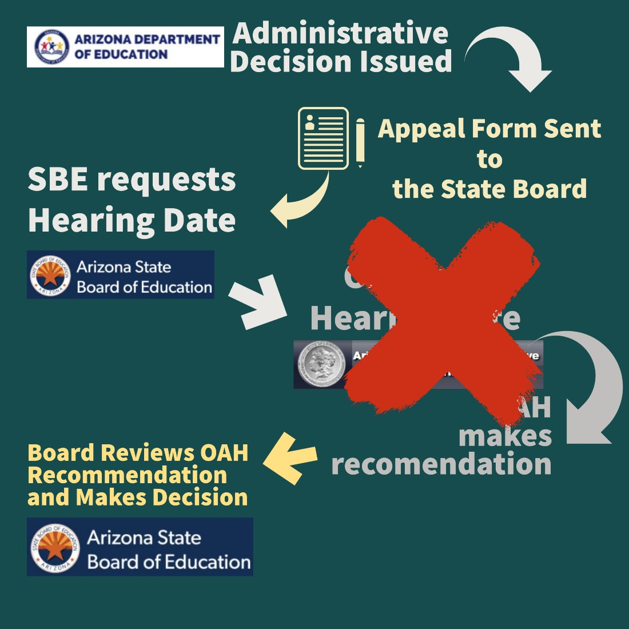
Current Appeals Process

Slide 10
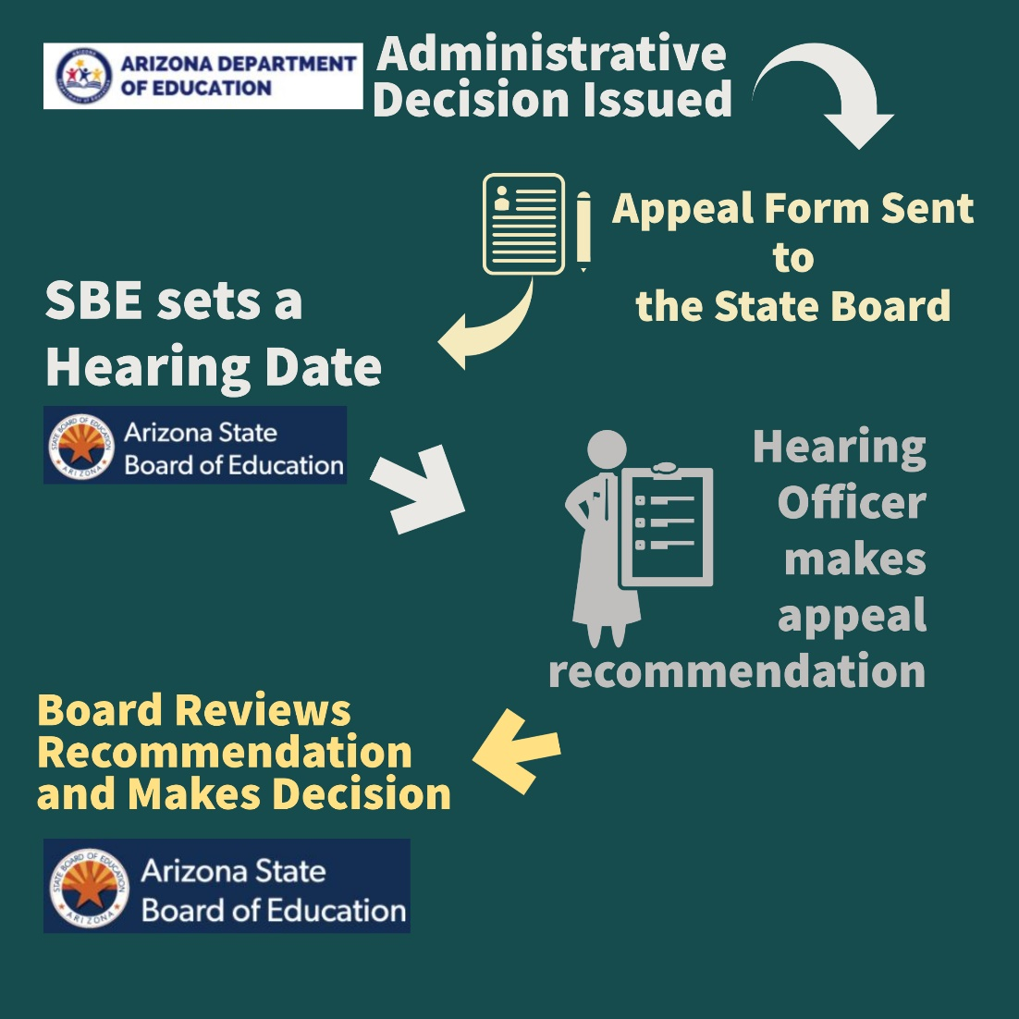
Updated Appeals Process

Slide 11
What is being changed in the rule after September? (highlighted text)
Removes quarterly expense reports and replaces with current expense options
Consistent with the Parent Handbook, allows parents to provide an IEP, evaluation or letter from a qualified service provider to serve as documentation for an associated good
Clarifies the process for reactivating accounts that have been closed for non-renewal
Requires the expense review process to be included in the parent handbook rather than simply online

Slide 12
What is being changed in the rule after September? (highlighted text)
Only requires parents to submit quarterly attestations if they did not make any expenses in the quarter
Requires ADE to include information on the appeals process in the Parent Handbook
After receiving an appeal recommendation, requires the Board to place the recommendation on one of the next two Board meetings rather than within 30 days
Implements the new appeals process beginning January 1, 2022
Notice of appealable actions via certified mail or electronic communication?

Slide 13
What is not in the Rule?
Administrative functions are not included in the rule
Dictating to the Arizona Department of Education on how to administer the ESA Program.
This includes internal standard operating procedures that drive how ADE administers the Program on a day to day basis.
Oversight of ADE staff
This includes how the staff is organized, how it answers calls or emails and how quickly it does so, etc.
Changes that are restricted by statute

Slide 14
Considerations for the Legislature
Hours required in online school (Arizona Online Instruction) to be eligible for an ESA
Definition of “accredited private postsecondary institution”
Parent advocates in the appeals process
Allowable expenses
Consumables
Technology and computer hardware
Privacy
3rd Party Evaluation Clarification
Curriculum by parents as a supplement material or as curriculum
More than 10 days to rectify before removal

Slide 15
Next Steps
Fill Out Survey to Provide Feedback
COPY and PASTE link into URL: https://forms.gle/JuMF9veMdsqWgSzM9
Or click on the link provided in the chat
Or visit the website: https://azsbe.az.gov/empowerment-scholarship-account-esa-program
Survey will close on Monday, November 29th at 5:00PM
All feedback from the survey will be provided to the Board

Slide 16
Subsequent Next Steps
Monday, December 13th at 10:00 A.M.
The Board will consider the changes and may adopt the rules

Slide 17
Questions and Discussion
Katherine Ruiz, ESA Project Director
Catcher Baden, Deputy Director
Alicia Williams, Executive Director
esafeedback@azsbe.az.gov
https://azsbe.az.gov/empowerment-scholarship-account-esa-program

