Slide 1
Center on School Turnaround at WestEd

Slide 2
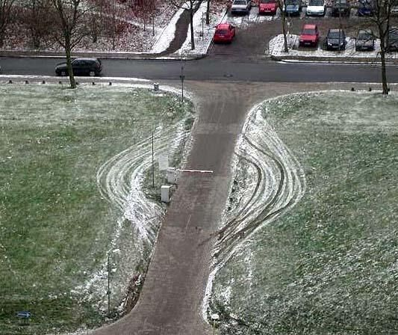
“Every system is perfectly designed to get the results it gets.”
—Quotation from Paul Batalden, M.D.
Notes:
It takes 3 to 5 years to turnaround a school
Turnaround is a trajectory
Do we have a system designed for support?
Given the number of schools identified, staff expertise, funding, etc?

Slide 3
What does the research say?

Slide 4
Change Efforts Fail When….
Not focused on a few high-leverage priorities
Insufficiently rigorous in its expectations
Inadequately rooted in research-based practice
Not focused on implementation fidelity as well as program/intervention fidelity
Not monitored by a core team committed to its success
Too rigid, inflexible, and absent performance management procedures for making necessary changes in course

Slide 5
Efforts also fail when...
They are primarily top down
They do not provide opportunities to learn from and with each other
They do not acknowledge and reach out to apathetic and resistant stakeholders.
In complex change, everybody
is a leader and a learner.

Slide 6
Four Domains For Rapid School Improvement: A Systems Framework
Notes:
This framework is built of what we’ve learned through the research – these four areas are critical for any sustained and systemic turnaround efforts.

Slide 7
The Four Domains
Notes:
The four domain areas are not in isolation and cut across the entire ecosystem – school, district, and state– as well regional partners and others

Slide 8
Turnaround Leadership Discussion
Acknowledge the unique challenges of leading school turnaround.
Identify leader competencies and actions associated with turnaround success.
Understand the importance of competencies in turnaround leader selection and development.
Analyze school leader behaviors to identify evidence of competencies.

Slide 9
Activity: What Sets Turnaround Leaders Apart?
Leading in Higher- Performing School
Leading in Turnaround School

Slide 10
Turnaround Leadership

Slide 11
Turnaround Leader Competencies
Driving for Results
Achievement / Focus on Results
Influencing for Results
Impact and Influence
Problem Solving
Analytical Thinking
Conceptual Thinking
Monitoring & Directiveness / Holding People Accountable
Initiative & Persistence
Planning Ahead
Personal Effectiveness
Team Leadership / Engaging the Team
Developing Others
Self-Confidence / Commitment to Student Achievement
Belief in Learning Potential
(Public Impact, 2008; UVA Partnership for Leaders in Education, 2014)
Notes:
Language for Facilitator’s Guide:
“Studies on turnarounds indicate:
1) that there are specific competencies that are necessary to be successful in leading turnaround efforts,
2) that these competencies can be used to attract and select leaders for turnaround schools, and
3) that these competencies can be developed and refined over time.
The enclosed Turnaround Leader Competencies handout includes a list of competencies that are identified by both Public Impact and UVA Darden/Curry Partnership for Leaders in Education.
Research is underway, by UVA, Public Impact and others, to validate and refine the turnaround leader competencies and actions associated with successful school turnaround efforts.
Original sources can be found in the references at the end of this module.”

Slide 12
Leveraging Leaders
“The importance of leadership begs the questions of how to identify, support, and retain high quality principals, especially in turnaround schools where their influence is needed most.”
(Zhu, Hitt, & Woodruff, 2015, p. 4)

Slide 13
Turnaround Leaders
“Turnaround efforts are made when organizations are in a state of entrenched failure.
Leaders who would otherwise succeed often fall short in a turnaround.”
(Steiner & Hassel, 2011, p. 2)

Slide 14
Turnaround Leader Actions

Slide 15
Turnaround Leader Actions
Focus on a Few Early Wins; Use the Momentum
Lead a Turnaround Campaign
Get the Right Staff; Right the Remainder
Drive Decisions with Open-Air Data
Break Organization Norms
Do What Works; Raise the Bar
Material adapted from SchoolTurnarounds.org ©Public Impact 2015.

Slide 16
Debrief: Turnaround Leader Actions
How well do these actions align with the distinguishing characteristics for which you may be aware?
What does this confirm for you?
What surprises you?

Slide 17
Turnaround Leader Competencies

Slide 18
Competencies
Competencies are underlying motives and habits—or patterns of thinking, feeling, acting, and speaking—that cause a person to be successful in a specific job or role.
Competencies lead to actions that lead to outcomes.
Competencies explain some of the differences in performance levels of leaders.
(Steiner & Hassel, 2011)

Slide 19
Competencies
“Competency research suggests that outstanding performance in complex jobs—ones in which most candidates have a similar educational history and significant autonomy over daily work tasks—is driven more by underlying competencies than by readily observed skills and knowledge.”
(Steiner & Hassel, 2011, p. 5)

Slide 20
Turnaround Leader Competencies
Key Competencies
Achievement/Focus on Results
The drive and actions to set challenging goals and reach a high standard of performance despite barriers
Taking responsibility to improve school outcomes and implement initiatives to accomplish sustainable results
Impact and Influence
Acting with the purpose of affecting the perceptions, thinking, and actions of others

Slide 21
Turnaround Leader Competencies
Key Competencies
Team Leadership/Engaging the Team
Assuming authoritative leadership of a group for the benefit of the organization
Working with a group to leverage their input, develop actionable goals, and implement change in a school
Conceptual Thinking
The ability to see patterns and links among seemingly unrelated things
Analytical Thinking
The ability to break things down in a logical way and to recognize cause and effect

Slide 22
State/District Example
Center on school turnaround

Slide 23
Principal Supervisors
The primary roles of the principal supervisor are:
Professional development and coaching
Evaluation and feedback
Liaison between school and district
Buffering and barrier removal
The role of principal supervisors becomes more important when we consider the potential they have to bolster efforts of turnaround principals through individualization.

Slide 24
Principal Supervisors
Principal supervisors should:
Have a limited number of turnaround principals.
Have weekly interactions with each turnaround principal.
Develop and participate in evaluation of their turnaround principals.
Be thoughtfully matched with turnaround principals

Slide 25
Supervision of Principals
Strategic and focused on improving performance
Ongoing opportunities for Training
Consistent with best practices
Informed practice

Slide 26
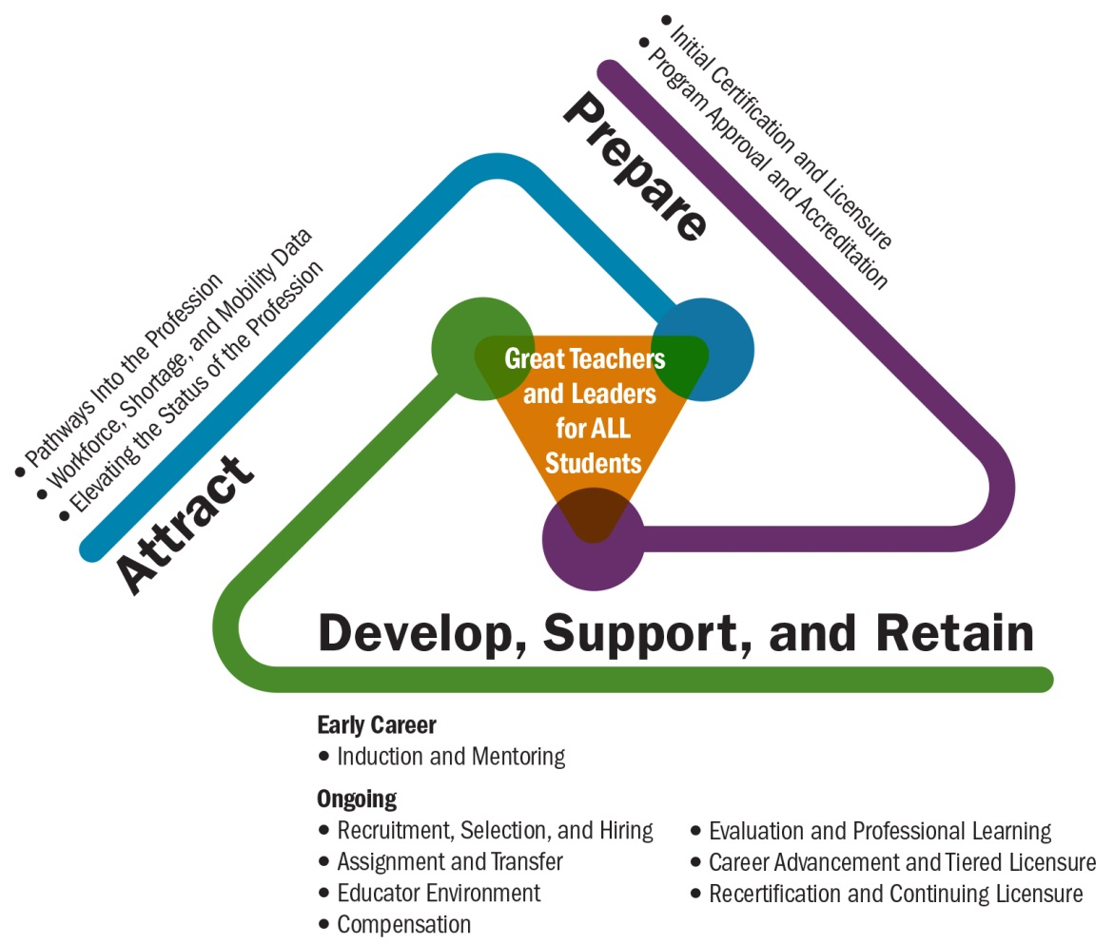
Talent Development Framework
(Center on Great Teachers and Leaders, 2014)
(Center on Great Teachers and Leaders, 2014)

Slide 27
Sustaining Turnaround
Center on school turnaround

Slide 28
Things to Consider:
What’s Working/What’s not working
Cost/benefit analysis and return on investment
Staffing
Building staff capacity
Repurposing staff
Culture shift can be sustained
Reallocation of Resource
Reevaluating partner agreements
Meaningful stakeholder engagement (policymakers, service providers, community partners, parents, families)

Slide 29
What States Are Doing?
Planning for sustainability “early”
LEA capacity building
Building foundation around hiring practices
LEAs assume leadership mentoring, coaching, and sustainability support
Improving school climates to retain effective teachers
Modifying Policies
Renegotiating collective bargaining agreements
Reallocating resources
Establishing data systems
SEAs
Revising SSOS
Guidance on resources

Slide 30
Rural School Discussion

Slide 31
Key Takeaway
Clearly stated role of the SEA
Clearly stated role identified by the SEA.

Slide 32
Defining the SEA Role
Disseminate Information and sponsor learning opportunities.
Role in expanding the pool of leaders and teachers available for recruitment and strategic use of staff.
Organize and incentivize regional consortia, including those through intermediate agencies.
Maintain focus on instructional supports.
Provide adequate hands on staff support.
Active engagement of the chief state school officer in targeted turnaround efforts.

Slide 33
What is Turnaround Success

Slide 34
Indicators
An Indicator of Effective Practice requires evidence of its implementation but is not, in itself, the evidence.
An Indicator of Effective Practice bridges the ultimate goals to the more immediate, operational objectives that allow for nimble response.
Milestones are the large pieces of work to implement the strategies. In fact, they are indicators of strategy implementation.

Slide 35
The Four Domains
Notes:
The four domain areas are not in isolation and cut across the entire ecosystem – school, district, and state– as well regional partners and others

Slide 36
What’s Worked and hasn’t…....
TECHNICAL PROBLEMS | ADAPTIVE CHALLENGES
Easy to identify | Difficult to identify (easy to deny)
Often lend themselves to quick and easy (cut-and-dried) solutions | Require changes in values, beliefs, roles, relationships and approaches to work
Often can be solved by an authority or expert | People with the problem do the work of solving it
Require change in just one or a few places; often contained within organizational boundaries | Require change in numerous places; usually across organizational boundaries
People are generally receptive to technical solutions | People often resist acknowledging adaptive challenges
Solutions can often be implemented quickly – even by edict | “Solutions” require experiments and new discoveries; they can take a long time to implement and cannot be implemented by edict
Notes:
Past practice has focused on technical problems – e.g. groups of students that are below targets,
Adaptive problems require the systemic thinking needed for system change – building belief systems and capacity.

Slide 37
QUESTIONS

