Slide 1
K-8 Model Refinements
Dr. Jennifer Fletcher, ADE

Slide 2
Agenda
K-8 Model
9-12 Models
Follow-Up Items

Slide 3
K-8 Business Rules
Business Rules
Only included schools who served grades 3-8.
Used FY16 data unless the calculation (i.e., growth, B25, T25) required two years in which case we also included FY15 data.
FAY data only.
8th grade students who took a HS EOC math assessment were utilized for calculations.
All tests needed to have a valid test score in order to be counted.
All proficiency calculations utilized the adjusted 95% denominator per ESSA if the school tested less than 95% of students.
If a school did not meet the n count of 20 for ELLs, the school was rated out of 90 points rather than 100.
Excluded schools with less than 30 test records (i.e., small schools), alternative schools, AOIs, k-12 schools, and k-2 schools from the analysis.
Notes:
8th grade students – per ESSA law (section 1111(b)(2)(C) ) the only students we are permitted to include in accountability regarding advanced students are 8th graders who take HS EOC in math (not ELA).

Slide 4
K-8 Model
Category | Component | Weight | Points/Percent
Proficiency | ELA, Math, and Science Proficiency | 40% | 40%
Growth | SGP ELA, Math | 15% | 40%
 | SGT ELA, Math | 15%
 | Bottom 25% Students’ Growth | 10%
ELL | ELL Proficiency on AZELLA | 5% | 10%
 | ELL Growth on AZELLA | 5%
Additional Indicators | Best 2 of: Top 25% Students’ AzMERIT Performance (ELA and Math), Decrease in % of grade 3 students below MOWR threshold, Increase in grade 8 students taking AzMERIT HS EOC | 5% | 10%
 |  | 5%
Notes:
Proficiency: combined total number of students proficient on ELA, math, science/number of students tested (adjusted for schools testing less than 95%). Weighted: MP = 0; PP = .6; P = 1; HP = 1.10: 95% denominator adjustment.
Growth: SGP – categorical (5 categories with typical rated at 1); SGT – categorical (6 categories) looks at where does the student need to go to meet the target; B25 = 5% SGP; 5% change in percent proficient
ELL proficiency: combined total number of students proficient on AZELLA divided by number of students tested (adjusted for schools testing less than 95%). Kept ELL n count at 20 to control variables to see the impact the growth change had. We can rerun using ELL n count 10. proficiency = weighted P-E/E = 0; B = .25; I = .5; P = 1.
ELL growth: combined total number of students who improved at least one proficiency level on AZELLA divided by number of students tested in both 2015 and 2016 (excluding students who were highly proficient in 2015 as they had no where to grow). Weighted = each level = 1 point.
Top 25%: students in T25 in 2015 who maintained or improved on AzMERIT ELA/Math in 2016/number of T25 students.
MOWR: 2015 3rd grade students compared to 2016 3rd grade students: did the percent below the MOWR threshold decrease? (Yes or No)
HS EOC: Gr. 8 students in 2015 taking HS EOC compared to gr. 6-8 students in 2016 taking HS EOC: did the number of students (the participation rate) increase? (Yes or No)

Slide 5
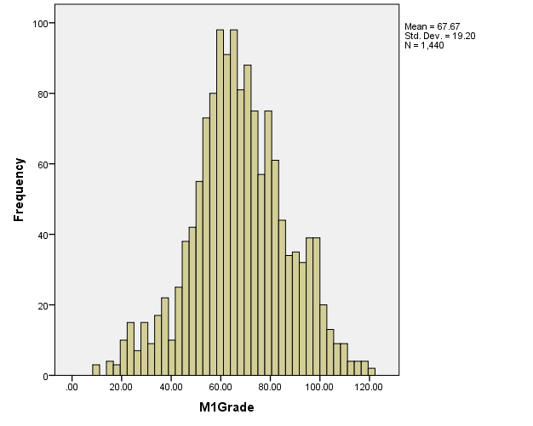
K-8 Model

Slide 6
K-8 Model Projected Letter Grades
70% or higher total points = A, 60-69% = B, 50-59% = C, below 50% = D

Slide 7
Non-Title I vs. Title I

Slide 8
Title I Schools FY 14 vs FY 16

Slide 9
Non-Title I Schools FY 14 vs. FY 16

Slide 10
Letter Grade by Percentage of Free and Reduced Lunch Students

Slide 11
K-8 Model
2016 Projected Letter Grades and Proficiency
85% of A schools had more than 50% of their students proficient on AzMERIT
23% of B schools had more than 50% of their students proficient on AzMERIT
8% of C schools had more than 50% of their students proficient on AzMERIT
19% of D schools had more than 50% of their students proficient on AzMERIT
2016 Projected Letter Grades and SGP
82% of A schools had more than 50% of their students with typical to very high growth
39% of B schools had more than 50% of their students with typical to very high growth
6% of C schools had more than 50% of their students with typical to very high growth
1% of D schools had more than 50% of their students with typical to very high growth
2016 Projected Letter Grades and SGT
87% of A schools had more than 50% of their students with typical to very close growth to target
35% of B schools had more than 50% of their students with typical to very close growth to target
4% of C schools had more than 50% of their students with typical to very close growth to target
0% of D schools had more than 50% of their students with typical to very close growth to target

Slide 12
9-12 Model Refinements

Slide 13
9-12 Business Rules
Business Rules
Only included schools who served grades 9-12.
Used FY16 data unless the calculation (i.e., growth) required two years in which case we also included FY15 data.
FAY data.
8th grade students who took a HS EOC math assessment were utilized for growth calculations.
All tests needed to have a valid test score in order to be counted.
If a school did not meet the n count of 20 for ELLs, the school was rated out of 90 points rather than 100.
Excluded schools with less than 30 test records (i.e., small schools), alternative schools, AOIs, and k-12 schools from the analysis.
Notes:
Keep in mind we are modeling using only 2 years of data. So this will not be a complete picture of how this data will look. If we continue to calculate proficiency this way, we currently interpret
ESSA law that says we cannot include students who took HS EOC in 8th grade in a 9-12 model. Students who take advanced courses prior to grade 9 will be excluded from both the numerator and the denominator.
Had to create a denominator for proficiency. Didn’t use FAY for proficiency because we didn’t know which FAY to use.

Slide 14
Model 1: 40/20 Proficiency/Growth
Category | Component | Weight | Points/Percent
Proficiency | ELA, Math, and Science Proficiency | 40% | 40%
Growth | SGP ELA | 10% | 20%
 | School Level Change Algebra 2 | 10%
ELL | ELL Proficiency on AZELLA | 5% | 10%
 | ELL Growth on AZELLA | 5%
College and Career Ready | (College-Ready/Total # of Graduates) + (Career-Ready/Total # of Graduates) | 15% | 15%
Graduation Rate | 4-year | 10% | 15%
 | 5-year | 3%
 | 6-year | 1%
 | 7-year | 1%
Notes:
Percent Proficient:
Grades 9, 10, 11 EOC AzMERIT ELA, Math; AIMS Science
FAY
Invalid test records count as not tested
Schools are accountable only to tests that occur in current year
Numerator Weighting:
Minimally Proficient = 0
Partially Proficient = .6
Proficient = 1
Highly Proficient = 1.1
Denominator:
95% tested adjustment for schools that tested <95% of their 9,10, 11th grade FAY students, who were supposed to test*
For schools who tested >=95%, number of 9th, 10th, 11th grade FAY students tested
*Who “should” have tested:
Assumes students enrolled in Grade 9, Grade 10, or Grade 11 would take at least one EOC each year (over last 3 years), per subject
Exception is a student who already took all 3 EOC in a subject. Those students are removed from denominator and numerator (for the subject already completed).
May need to find additional exceptions in the interim for grade 11 students who wouldn’t have taken any AzMERIT because they were passed those EOCs when AzMERIT was introduced.
Growth: SGP (5 categories) – ELA; school level change in percent proficient Algebra 2 – divided into 5 categories (normal distribution at state level) and assigned points.
ELL proficiency: combined total number of students proficient on AZELLA divided by number of students tested (adjusted for schools testing less than 95%). Weighted.
ELL growth: combined total number of students who improved at least one proficiency level on AZELLA divided by number of students tested in both 2015 and 2016 (excluding students who were highly proficient in 2015 as they had no where to grow). Weighted.
CCR: College-Ready: passed ACT, SAT, PSAT, or AP course; Career-Ready; passed CTE skills-assessment. Used a distribution → if 90% of students were college/career ready got all 15 points; 80% received 13 points; 70% 11 points; 60% 9 points; 50% 7 points; remaining received the percentage they earned. This was done to incentive schools to get to high levels of career and college ready students.
36,718 students (30%) were either college or career ready.
Grad rate – weighted 4-year the heaviest.

Slide 15
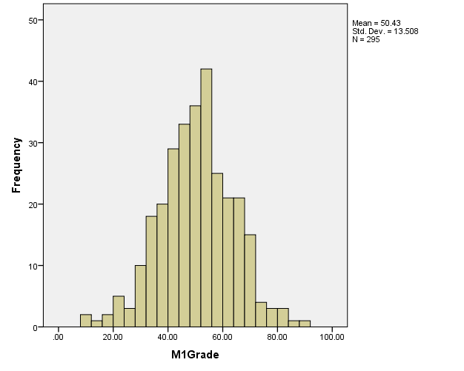
Model 1

Slide 16
Model 1: Projected Letter Grades

Slide 17
Model 1: Non-Title I vs. Title I

Slide 18
Model 1: Title I Schools Letter Grades for FY 14 and FY 16

Slide 19
Model 1: Non-Title I Schools Letter Grades for FY 14 and FY 16

Slide 20
Model 1: Letter Grade by Percentage of Free and Reduced Lunch Students

Slide 21
Model 2: 30/30 Proficiency/Growth
Category | Component | Weight | Points/Percent
Proficiency | ELA, Math, and Science Proficiency | 30% | 30%
Growth | SGP ELA | 15% | 30%
 | School Level Change Algebra 2 | 15%
ELL | ELL Proficiency on AZELLA | 5% | 10%
 | ELL Growth on AZELLA | 5%
College and Career Ready | (College-Ready/Total # of Graduates) + (Career-Ready/Total # of Graduates) | 15% | 15%
Graduation Rate | 4-year | 10% | 15%
 | 5-year | 3%
 | 6-year | 1%
 | 7-year | 1%
Notes:
Percent Proficient:
Math and ELA-
check if student took all 6 EOC tests at any time between grade 8 and grade 11
if student took the same EOC twice, keep the higher of the 2 scores
Percent passing is all students enrolled, counted 6 times (once per possible EOC test)
Numerator: if student passed =1, if student failed or hasn’t taken= 0
Science-
Check if student took science “grade 10” test in 2014 or 2015 (for this year of data, that’s if they took it in grade 9 or 10)
If student took science twice, keep the higher of the 2 scores
Percent proficient is all students enrolled, counted 6 times (once per possible EOC test)
Numerator: if student passed =1, if student failed or hasn’t taken= 0
Growth: change in student scale score from 2015 to 2016. aggregated so that all students in school, then standardized.
ELL proficiency: combined total number of students proficient on AZELLA divided by number of students tested (adjusted for schools testing less than 95%).
ELL growth: combined total number of students who improved at least one proficiency level on AZELLA divided by number of students tested in both 2015 and 2016 (excluding students who were highly proficient in 2015 as they had no where to grow).
CCR: College-Ready: passed ACT, SAT, PSAT, or AP course; Career-Ready; passed CTE skills-assessment. (Task Force recommendation). Used a distribution → if 90% of students were college/career ready got all 15 points; 80% received 13 points; 70% 11 points; 60% 9 points; 50% 7 points; remaining received the percentage they earned. This was done to incentive schools to get to high levels of career and college ready students.
32454 students (27%) were either college or career ready; 4263 (4%) were both college- and career-ready.

Slide 22
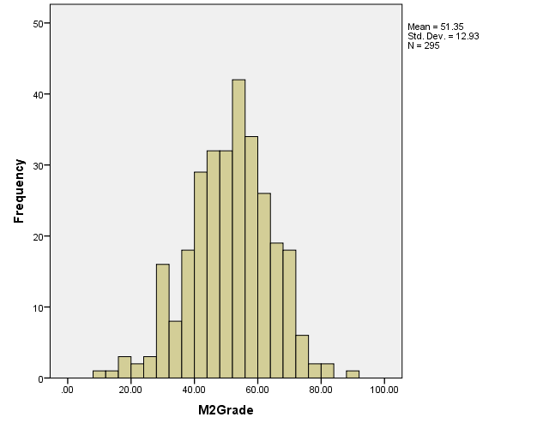
Model 2

Slide 23
Model 2: Projected Letter Grades
88
77
75
55

Slide 24
Model 2: Non-Title I vs. Title I

Slide 25
Model 2: Title I Schools Letter Grades for FY 14 and FY 16

Slide 26
Model 2: Non-Title I Schools Letter Grades for FY 14 and FY 16

Slide 27
Model 2: Letter Grade by Percentage of Free and Reduced Lunch Students

Slide 28
Model 3: Scale Score Change
Category | Component | Weight | Points/Percent
Proficiency | ELA, Math, and Science Proficiency | 40% | 40%
Growth | ELA and Math Scale Score Change | 20% | 20%
ELL | ELL Proficiency on AZELLA | 5% | 10%
 | ELL Growth on AZELLA | 5%
College and Career Ready | (College-Ready/Total # of Graduates) + (Career-Ready/Total # of Graduates) | 15% | 15%
Graduation Rate | 4-year | 10% | 15%
 | 5-year | 3%
 | 6-year | 1%
 | 7-year | 1%
Notes:
Percent Proficient: weighted: MP = 0, PP=.6, P = 1, HP = 1.1.
Math and ELA-
check if student took all 6 EOC tests at any time between grade 8 and grade 11
if student took the same EOC twice, keep the higher of the 2 scores
Percent passing is all students enrolled, counted 6 times (once per possible EOC test)
Numerator: if student passed =1, if student failed or hasn’t taken= 0
Science-
Check if student took science “grade 10” test in 2014 or 2015 (for this year of data, that’s if they took it in grade 9 or 10)
If student took science twice, keep the higher of the 2 scores
Percent proficient is all students enrolled, counted 6 times (once per possible EOC test)
Numerator: if student passed =1, if student failed or hasn’t taken= 0
Growth: change in student scale score from 2015 to 2016. aggregated so that all students in school, then standardized.
ELL proficiency: combined total number of students proficient on AZELLA divided by number of students tested (adjusted for schools testing less than 95%).
ELL growth: combined total number of students who improved at least one proficiency level on AZELLA divided by number of students tested in both 2015 and 2016 (excluding students who were highly proficient in 2015 as they had no where to grow).
CCR: College-Ready: school level – total number of students who passed AP, plus total number of students who passed ACT, plus total number of students who passed ACT; total number of students who passed CTE assessment + total number of students who did work-based learning (internship or cooperative education).

Slide 29
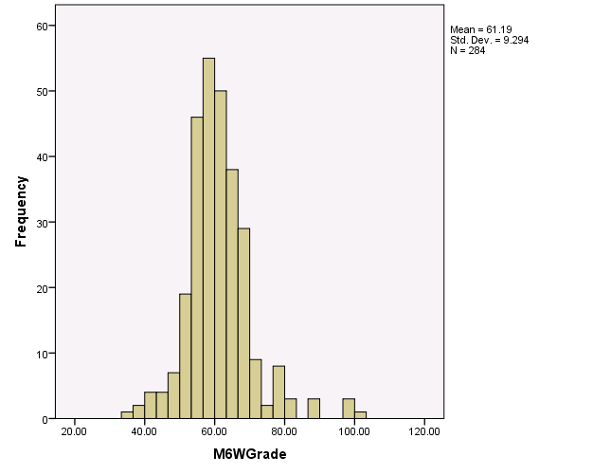
Model 3

Slide 30
Model 3: Projected Letter Grades
70% or higher total points = A, 60-69% = B, 50-59% = C, below 50% = D
Notes:
Overall, schools are not performing as well as on AIMS.

Slide 31
Model 3: Non-Title I vs. Title I

Slide 32
Model 3: Title I Schools Letter Grades for FY 14 and FY 16

Slide 33
Model 3: Letter Grade by Percentage of Free and Reduced Lunch Students

Slide 34
Follow-Up Items

Slide 35
Follow-Up Items
Personal Curriculum:
ADE does not have information on how many students have personal curriculum for Algebra 2; data is not required to be collected on these students at this time.
They are not required to take Algebra 2 EOC AzMERIT.
AOIs:
Approximately 33,000 students in the state enrolled in an AOI, with roughly 21,000 of them being concurrently enrolled.
Students take a wide array of courses from core to elective, ranging from one course to several at a time.
Roughly 8,000 students were FAY last year in the fall; and 8,000 in spring.
DRPs
4 in FY16 with enrollment ranging from 100 to 1600 students.
DRPs have extremely mobile students.
*currently included in K-8 model per ESSA exception.

Slide 36
Follow-Up Items
Grades 6-8 students taking HS EOC
 | Enrolled Grade 6 | Enrolled Grade 7 | Enrolled Grade 8
ELA 9 | 1 | 2 | 104
ELA 10 | 0 | 0 | 0
ELA 11 | 0 | 0 | 1
Algebra 1 | 328 | 2,646 | 13,307*
Geometry | 49 | 471 | 2,515*
Algebra 2 | 0 | 11 | 137*

Slide 37
Follow-Up Items
Unique School Configurations
Grades Served | Number of Schools | Model Impact
K-3 | 28 | 3rd graders won’t have growth
1-3 | 1 | 3rd graders won’t have growth
K-9 | 3 | Use K-8 model for K-8th grade; use 9-12 model for 9th grade
1-9 | 1 | Use K-8 model for K-8th grade; use 9-12 model for 9th grade
6-9 | 2 | Use K-8 model for K-8th grade; use 9-12 model for 9th grade
7-9 | 1 | Use K-8 model for K-8th grade; use 9-12 model for 9th grade

