Slide 1
Dr. Jennifer Fletcher, ADE

Slide 2
K-8 Models

Slide 3
Model 1
Category | Component | Weight | Points/Percent
Proficiency | Weighted ELA, Math, and Science Proficiency (0, .6, 1.0, 1.3) | 40% | 40%
Growth | SGP/SGT on ELA, Math (using a scaled weighting system) | 20% SGP 20% SGT | 40%
ELL | ELL Proficiency on AZELLA | 5% | 10%
 | ELL Growth on AZELLA | 5%
Acceleration/Readiness | Grades 5, 6, 7, 8 HS EOC combined, Grade 3 ELA MP, Chronic Absenteeism (total of 3) | 5% | 10%
Notes:
We did try disaggregating by grade HS EOC. It didn’t make a large difference in numbers, but that is an option.
No cap on growth needed. Cap on proficiency. 45 schools earned greater than 40 points. – 3%
None of the models at this time include the Special Education enrolment at 80% of state bonus points. 1248 schools (80%) would earn the points.

Slide 4
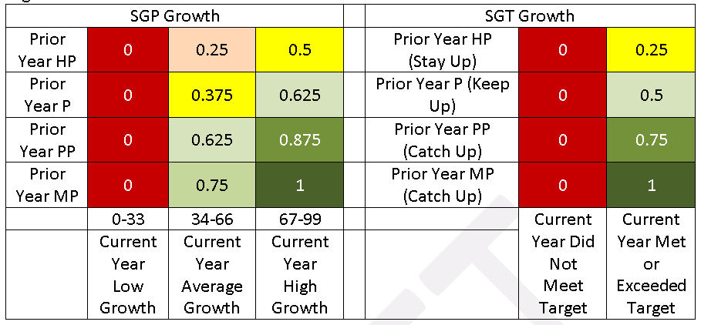
SGP/SGT Weight 1

Slide 5
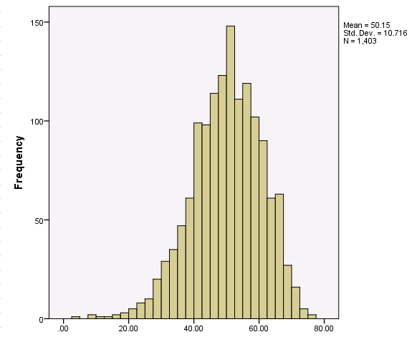
Model 1
Notes:
When compared to menu 2 – mean 40.28, SD 10.77

Slide 6
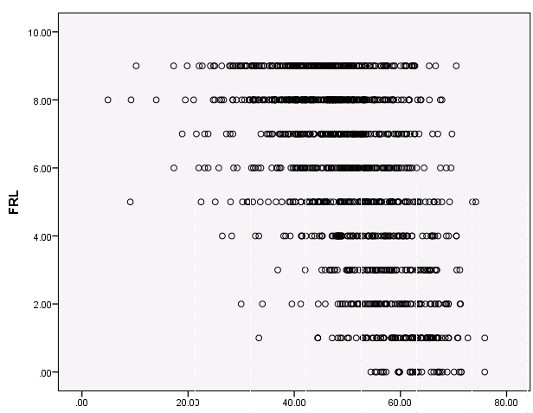
Free and Reduced Lunch Correlation

Slide 7
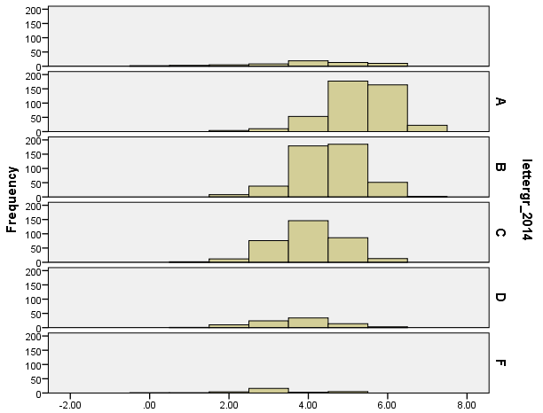
FY 14 Letter Grade Comparison
Notes:
-.52 correlation w/ FRL. P < .001.

Slide 8
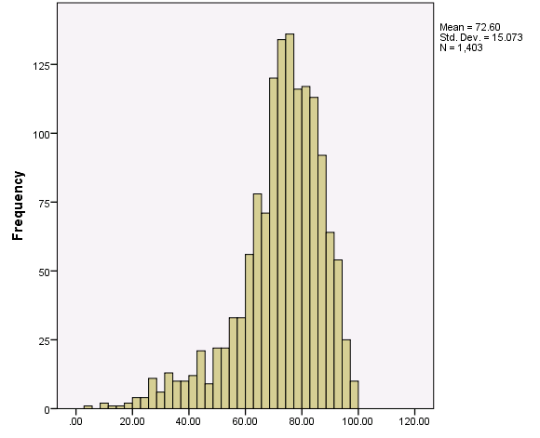
Model 2

Slide 9
Model 2
Category | Component | Weight | Points/Percent
Proficiency | Weighted ELA, Math, and Science Proficiency (0, .6, 1.0, 1.3) | 40% | 40%
Growth | SGP/SGT on ELA, Math (using a weighting system) | 20% SGP 20% SGT | 40%
ELL | ELL Proficiency on AZELLA | 5% | 10%
 | ELL Growth on AZELLA | 5%
Acceleration/Readiness | Grades 5, 6, 7, 8 HS EOC combined, Grade 3 ELA MP, Chronic Absenteeism (total of 3) | 5% | 10%
Notes:
We did try disaggregating by grade HS EOC. It didn’t make a large difference in numbers, but that is an option.
Cap on proficiency. 45 schools earned greater than 40 points. – 3%
Cap on growth. 809 schools – 63%
None of the models at this time include the Special Education enrolment at 80% of state bonus points. 1248 schools (80%) would earn the points.

Slide 10
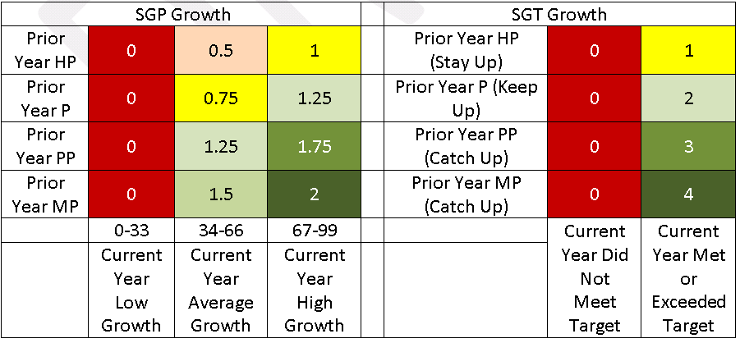
SGP/SGT Weight 2

Slide 11
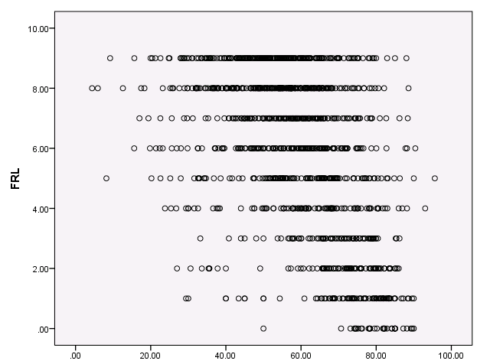
Free and Reduced Lunch Correlation
Notes:
Correlation = -.48, p .001

Slide 12
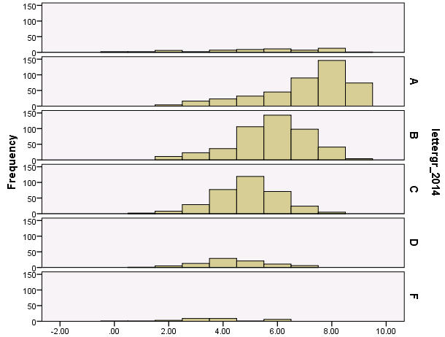
FY 14 Letter Grade Comparison

Slide 13
Model 3
Category | Component | Weight | Points/Percent
Proficiency | Weighted ELA, Math, and Science Proficiency (0, .6, 1.0, 1.3) | 40% | 40%
Growth | Florida Model Percentage Gains on ELA, Math | 20% ELA 20% Math | 40%
ELL | ELL Proficiency on AZELLA | 5% | 10%
 | ELL Growth on AZELLA | 5%
Acceleration/Readiness | Grades 5, 6, 7, 8 HS EOC combined, Grade 3 ELA MP, Chronic Absenteeism (total of 3) | 5% | 10%
Notes:
Cap on growth. 1268 – 99%
Cap on proficiency. 45 schools earned greater than 40 points. – 3%
None of the models at this time include the Special Education enrolment at 80% of state bonus points. 1248 schools (80%) would earn the points.

Slide 14
Florida Model Weighting System
No Growth is defined as no growth within or between any proficiency categories or bands within the minimally proficient or partially proficient categories. This definition would also include students that show negative growth between or within any proficiency categories or bands. For example, a student who was partially proficient as a 4th grader and then minimally proficient as a 5th grader. No (0) points are awarded in this category. (Red text no fill)
Low Growth is defined as growth from one proficiency band to the next proficiency band in the subsequent year. (E.g. MP 1-MP 2). This growth type would likely only apply to students in the MP or PP proficiency categories. 1.00 points are awarded in this category. (Yellow)
Typical Growth is defined as growth from one proficiency band to another proficiency band the next year that is two bands higher. (E.g. MP 3 – MP 5) Students that are in the Proficient or Highly Proficient categories would be considered as showing Typical Growth by staying in the same category as the previous year. For example, a student who is Minimally Proficient band 3 as a 4th grader and then Minimally Proficient band 5 as a 5th grader. 1.25 points are awarded in this category. (Green)
High Growth is defined as growth from one proficiency band across three proficiency bands the next year in the minimally or partially proficient categories. (PP 2 – PP 5) or if a student moves from one proficiency category to the next higher proficiency category in the subsequent year. For example, a student who is Minimally Proficient as a 4th grader and then Proficient as a 5th grader. 1.50 points are awarded in this category. (Blue)
Very High Growth is defined as growth from one proficiency band across four proficiency bands the next year in the minimally or partially proficient categories. Or, a student moves across two Proficiency categories. For example, a student who is Partially Proficient as a 4th grader and then Highly Proficient as a 5th grader. 1.75 points are awarded in this category. (Orange)

Slide 15
Florida Model Weighting System
Minimally Proficient |  |  |  |  |  | Partially Proficient |  | Proficient | Highly Proficient
MP1 --> MP1 | MP2 --> MP2 | MP3 --> MP3 | MP4 --> MP4 | MP5 --> MP5 | MP6 --> MP6 | PP1 --> PP1 | PP2 --> PP2 | P --> P | HP --> HP
MP1 --> MP2 | MP2 --> MP3 | MP3 --> MP4 | MP4 --> MP5 | MP5 --> MP6 | MP6 --> PP1 | PP1 --> PP2 | PP2 --> P | P --> HP
MP1 --> MP3 | MP2 --> MP4 | MP3 --> MP5 | MP4 --> MP6 | MP5 --> PP1 | MP6 --> PP2 | PP1 --> P | PP2 --> HP
MP1 --> MP4 | MP2 --> MP5 | MP3 --> MP6 | MP4 --> PP1 | MP5 --> PP2 | MP6 --> P | PP1 --> HP
MP1 --> MP5 | MP2 --> MP6 | MP3 --> PP1 | MP4 --> PP2 | MP5 --> P | MP6 --> HP
MP1 --> MP6 | MP2 --> PP1 | MP3 --> PP2 | MP4 --> P | MP5 --> HP
MP1 --> PP1 | MP2 --> PP2 | MP3 --> P | MP4 --> HP
MP1 --> PP1 | MP2 --> P | MP3 --> HP
MP1 --> P | MP2 --> HP
MP1 --> HP

Slide 16
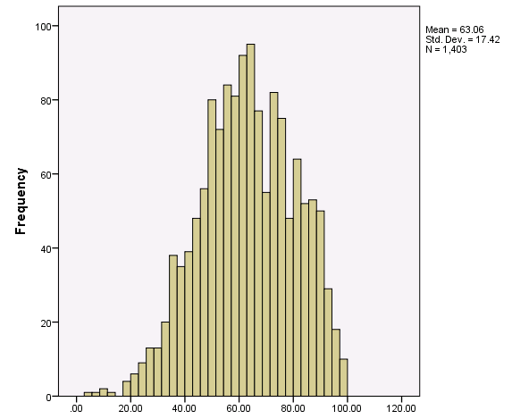
Model 3

Slide 17
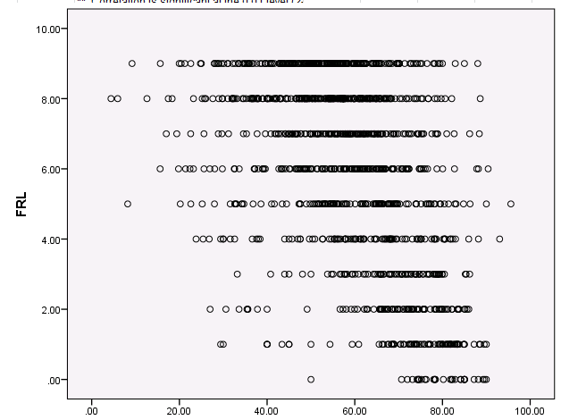
Free and Reduced Lunch Correlation
Notes:
Correlation = -.56, p < .001.

Slide 18
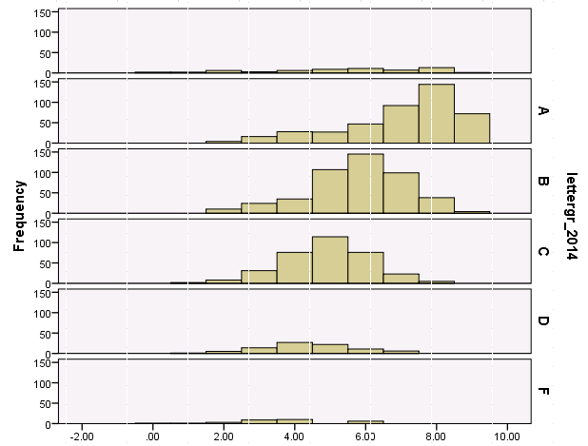
FY 14 Letter Grade Comparison

Slide 19
AAG Model
Category | Component | Weight | Points/Percent
Proficiency | ELA, Math, and Science Proficiency FAY 1 year and FAY 2 years (0, .6, 1.0, 1.3) | 20% FAY 1 year 20% FAY 2 years | 40%
Growth | SGP/SGT on ELA, Math (using a weighting system) | 20% SGP 20% SGT | 40%
ELL | ELL Proficiency on AZELLA | 5% | 10%
 | ELL Growth on AZELLA | 5%
Acceleration/Readiness | Grades 5, 6, 7, 8 HS EOC combined, Grade 3 ELA MP, Chronic Absenteeism, Second Language Acquisition (FEP), Special Education enrollment and percent proficient, Extra Proficiency/Growth points (total of 6) | Points awarded based on how many metrics for which school was eligible | 10%
Notes:
We did try disaggregating by grade HS EOC. It didn’t make a large difference in numbers, but that is an option.
Cap on proficiency. 45 schools earned greater than 40 points. – 3%
Cap on growth. 809 schools – 63%
Acceleration/Readiness
Out of 4:
4 out of 4= 10
3 out of 4= 7.5
2 out of 4= 5
1 out of 4= 2.5
O out of 4= 0
Out of 5:
5 out of 5= 10
4 out of 5= 8
3 out of 5 = 6
2 out of 5= 4
1 out of 5= 2.5
0 out of 5= 0
Out of 6:
6 out of 6= 10
5 out of 6= 8
4 out of 6= 7
3 out of 6 = 5
2 out of 6= 3
1 out of 6= 1
0 out of 6= 0

Slide 20
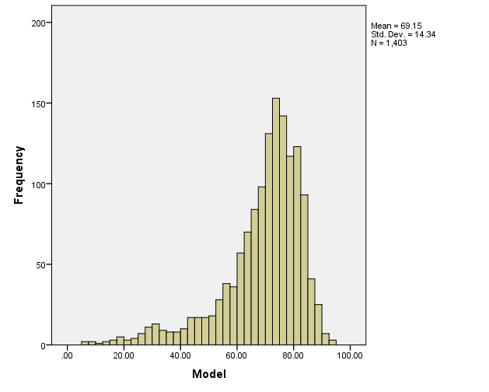
AAG Model

Slide 21
SGP/SGT Weight 2

Slide 22
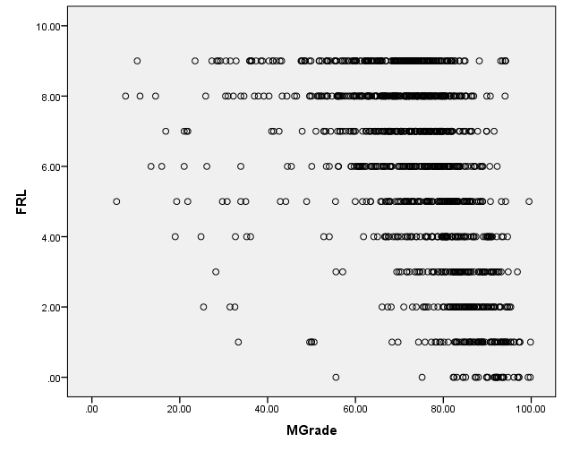
Free and Reduced Lunch Correlation
Notes:
Correlation = -.44, p < .001.

Slide 23
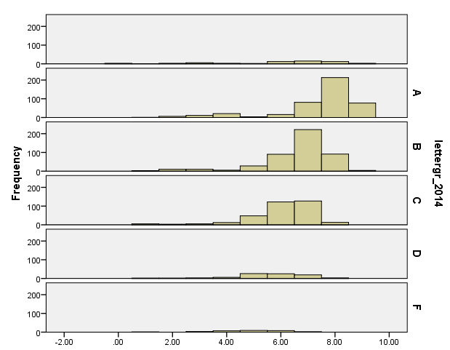
FY 14 Comparison

Slide 24
9-12

Slide 25
Model 1
Category | Component | Weight | Points/Percent
Proficiency | ELA, Math, and Science Proficiency (0, .6, 1.0, 1.3) | 40% | 40%
Growth | SGP ELA (unweighted system) Percent Proficient Change Algebra 2 | 10% SGP 10% Prof. Change | 20%
ELL | ELL Proficiency on AZELLA | 5% | 10%
 | ELL Growth on AZELLA | 5%
College and Career Ready * *Available data for these calculations will depend on which year(s) of data is being required and timing of letter grades. | Student level scoring Available data points: SAT, ACT, CTE skills attainment assessment, AP courses, AzMERIT | 15% | 15%
Graduation Rate | 4-year | 10% | 15%
 | 5-year | 3%
 | 6-year | 1%
 | 7-year | 1%
Notes:
Cap on proficiency. 8 schools – 3%.
Student level CCR. If using school level, increase the mean by 10-12 points and decrease the standard deviation by 1-2 points.

Slide 26
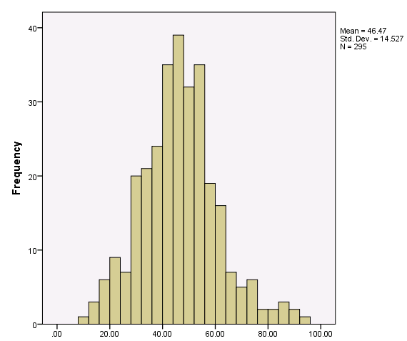
Model 1

Slide 27
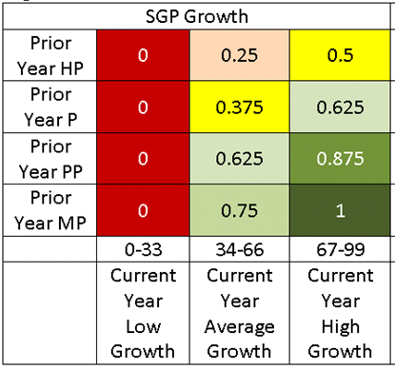
SGP Weight 1
Notes:
The points for percent proficient change, if that option is selected need to be reviewed.

Slide 28
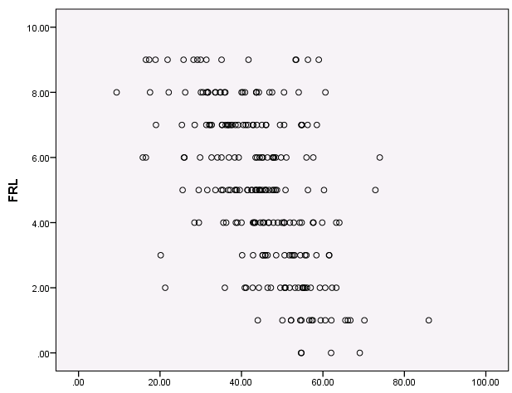
Free and Reduced Lunch Correlation
Notes:
Correlation = -.54, p < .001.

Slide 29
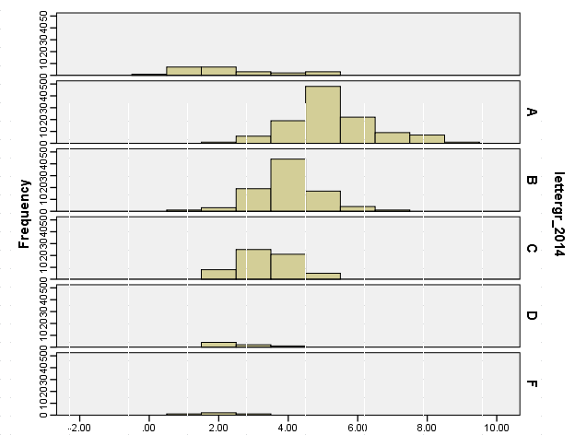
FY 14 Letter Grade Comparison

Slide 30
Model 2
Category | Component | Weight | Points/Percent
Proficiency | ELA, Math, and Science Proficiency (0, .6, 1.0, 1.3) | 40% | 40%
Growth | SGP/SGT on ELA, Math (using a unweighted system) | 20% SGP 20% SGT | 20%
ELL | ELL Proficiency on AZELLA | 5% | 10%
 | ELL Growth on AZELLA | 5%
College and Career Ready * *Available data for these calculations will depend on which year(s) of data is being required and timing of letter grades. | Student level scoring Available data points: SAT, ACT, CTE skills attainment assessment, AP courses, AzMERIT | 15% | 15%
Graduation Rate | 4-year | 10% | 15%
 | 5-year | 3%
 | 6-year | 1%
 | 7-year | 1%
Notes:
Cap on proficiency. 8 schools – 3%.
No cap on growth needed.

Slide 31
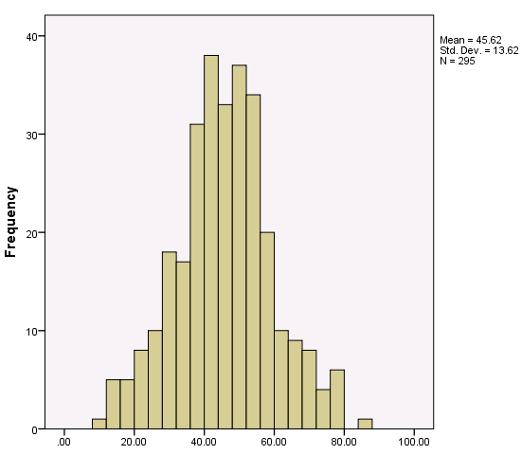
Model 2

Slide 32
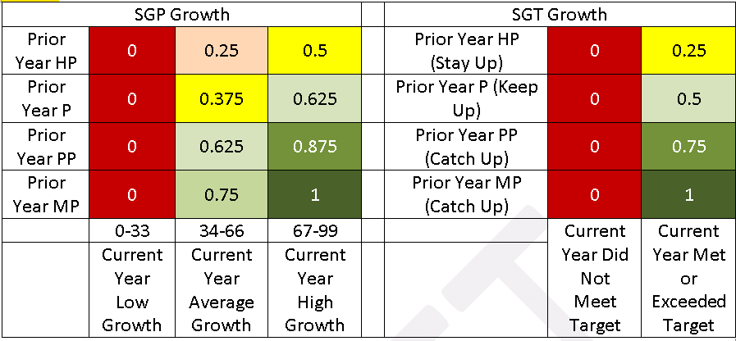
SGP/SGT Weight 1
Notes:
SGT only has one trajectory right now – Alg 1 → Geo → Alg 2

Slide 33
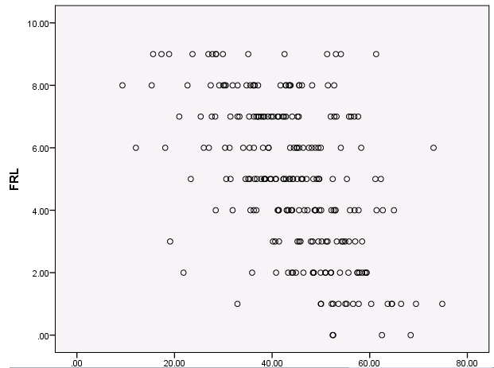
Free and Reduced Lunch Correlation

Slide 34
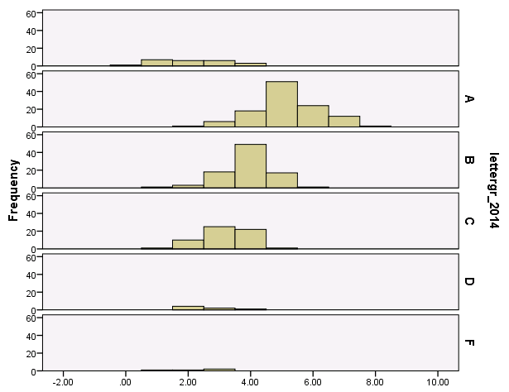
FY 14 Letter Grade Comparison
Notes:
-.53

Slide 35
Model 3
Category | Component | Weight | Points/Percent
Proficiency | ELA, Math, and Science Proficiency (0, .6, 1.0, 1.3) | 40% | 40%
Growth | Florida Model Percentage Gains on ELA, Math (using a weighted system) | 20% ELA 20% Math | 20%
ELL | ELL Proficiency on AZELLA | 5% | 10%
 | ELL Growth on AZELLA | 5%
College and Career Ready * *Available data for these calculations will depend on which year(s) of data is being required and timing of letter grades. | Student level scoring Available data points: SAT, ACT, CTE skills attainment assessment, AP courses, AzMERIT | 15% | 15%
Graduation Rate | 4-year | 10% | 15%
 | 5-year | 3%
 | 6-year | 1%
 | 7-year | 1%

Slide 36
Florida Model Weighting System
No Growth is defined as no growth within or between any proficiency categories or bands within the minimally proficient or partially proficient categories. This definition would also include students that show negative growth between or within any proficiency categories or bands. For example, a student who was partially proficient as a 4th grader and then minimally proficient as a 5th grader. No (0) points are awarded in this category. (Red text no fill)
Low Growth is defined as growth from one proficiency band to the next proficiency band in the subsequent year. (E.g. MP 1-MP 2). This growth type would likely only apply to students in the MP or PP proficiency categories. 1.00 points are awarded in this category. (Yellow)
Typical Growth is defined as growth from one proficiency band to another proficiency band the next year that is two bands higher. (E.g. MP 3 – MP 5) Students that are in the Proficient or Highly Proficient categories would be considered as showing Typical Growth by staying in the same category as the previous year. For example, a student who is Minimally Proficient band 3 as a 4th grader and then Minimally Proficient band 5 as a 5th grader. 1.25 points are awarded in this category. (Green)
High Growth is defined as growth from one proficiency band across three proficiency bands the next year in the minimally or partially proficient categories. (PP 2 – PP 5) or if a student moves from one proficiency category to the next higher proficiency category in the subsequent year. For example, a student who is Minimally Proficient as a 4th grader and then Proficient as a 5th grader. 1.50 points are awarded in this category. (Blue)
Very High Growth is defined as growth from one proficiency band across four proficiency bands the next year in the minimally or partially proficient categories. Or, a student moves across two Proficiency categories. For example, a student who is Partially Proficient as a 4th grader and then Highly Proficient as a 5th grader. 1.75 points are awarded in this category. (Orange)

Slide 37
Florida Model Weighting System
Minimally Proficient |  |  |  |  |  | Partially Proficient |  | Proficient | Highly Proficient
MP1 --> MP1 | MP2 --> MP2 | MP3 --> MP3 | MP4 --> MP4 | MP5 --> MP5 | MP6 --> MP6 | PP1 --> PP1 | PP2 --> PP2 | P --> P | HP --> HP
MP1 --> MP2 | MP2 --> MP3 | MP3 --> MP4 | MP4 --> MP5 | MP5 --> MP6 | MP6 --> PP1 | PP1 --> PP2 | PP2 --> P | P --> HP
MP1 --> MP3 | MP2 --> MP4 | MP3 --> MP5 | MP4 --> MP6 | MP5 --> PP1 | MP6 --> PP2 | PP1 --> P | PP2 --> HP
MP1 --> MP4 | MP2 --> MP5 | MP3 --> MP6 | MP4 --> PP1 | MP5 --> PP2 | MP6 --> P | PP1 --> HP
MP1 --> MP5 | MP2 --> MP6 | MP3 --> PP1 | MP4 --> PP2 | MP5 --> P | MP6 --> HP
MP1 --> MP6 | MP2 --> PP1 | MP3 --> PP2 | MP4 --> P | MP5 --> HP
MP1 --> PP1 | MP2 --> PP2 | MP3 --> P | MP4 --> HP
MP1 --> PP1 | MP2 --> P | MP3 --> HP
MP1 --> P | MP2 --> HP
MP1 --> HP

Slide 38
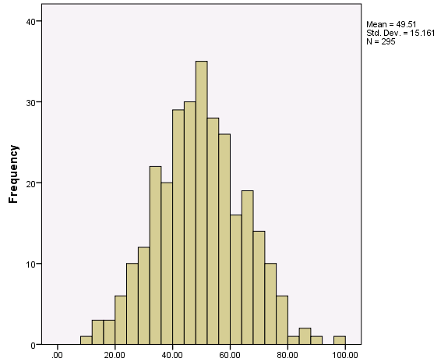
Model 3

Slide 39
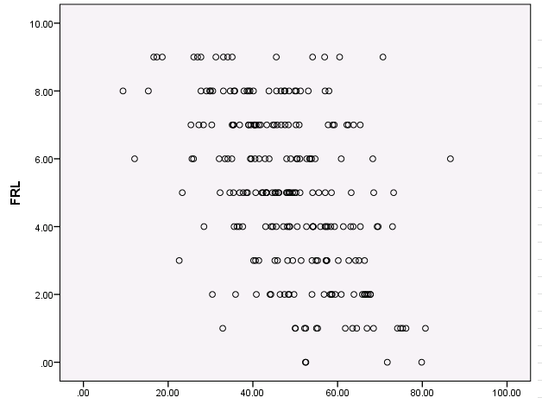
Free and Reduced Lunch Correlation
Notes:
Correlation = -.50, p < .001.

Slide 40
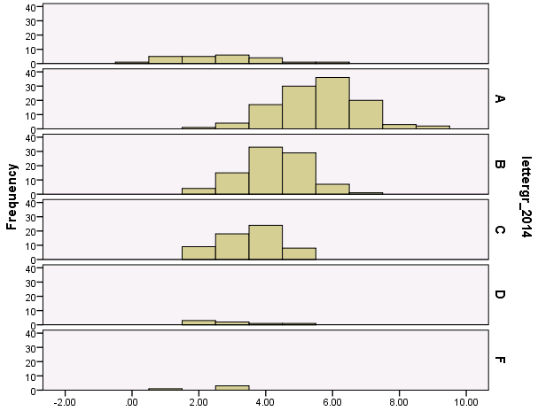
FY 14 Letter Grade Comparison

Slide 41
AAG Model
Category | Component | Weight | Points/Percent
Proficiency | ELA, Math, and Science Proficiency FAY 1 year and FAY 2 years (0, .6, 1.0, 1.3) | 20% FAY 1 year 20% FAY 2 years | 40%
Growth | SGP/SGT on ELA, Math (using a unweighted system) | 20% SGP 20% SGT | 20%
ELL | ELL Proficiency on AZELLA | 5% | 10%
 | ELL Growth on AZELLA | 5%
College and Career Ready* *Available data for these calculations will depend on which year(s) of data is being required and timing of letter grades. | Student level aggregated to school level: scoring based on an increase from one year to the next Available data points: SAT, ACT, CTE skills attainment assessment, AP courses, AzMERIT, postsecondary data, FAFSA submissions, extra proficiency/growth points | Points are awarded based on the number of metrics that are available to all schools – 5 items (AzMERIT Algebra 2, AzMERIT ELA Grade 11, postsecondary data, extra proficiency points, extra growth points) | 15%
Graduation Rate | 4-year | 10% | 15%
 | 5-year | 3%
 | 6-year | 1%
 | 7-year | 1%
Notes:
Out of 5:
3 out of 5= 15
2 out of 5= 10
1 out of 5= 5
0 out of 5= 0
70% of schools earned extra proficiency/growth points.

Slide 42
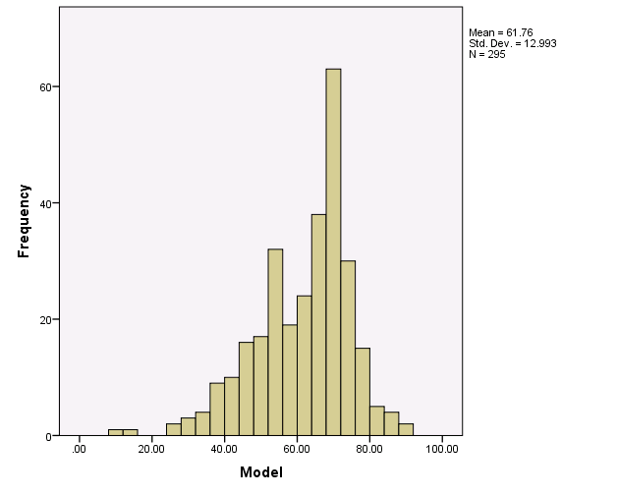
AAG Model

Slide 43
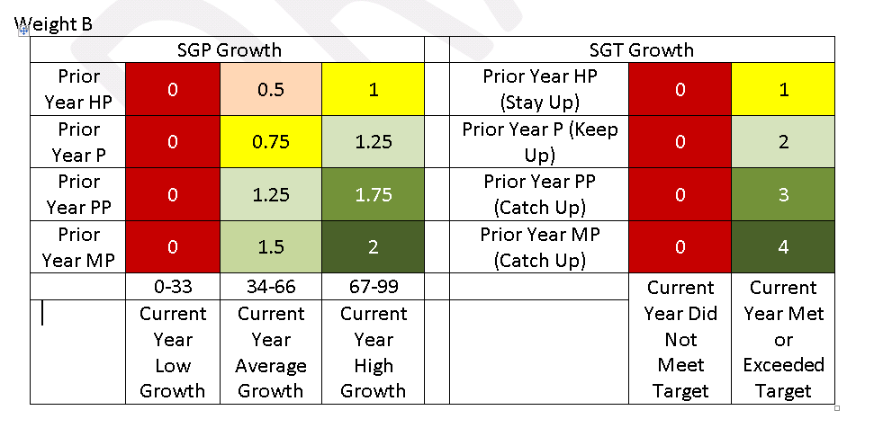
SGP/SGT Weight 2

Slide 44
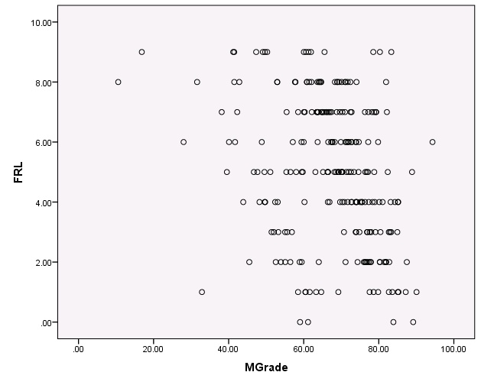
Free and Reduced Lunch Correlation
Notes:
Correlation = -.34, p < .001.

Slide 45
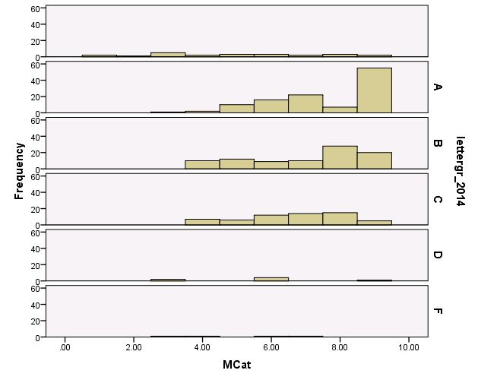
FY 14 Letter Grade Comparison

