Slide 1
Alternative Schools and Accountability
Wayne Tucker, Chair and Sue Durkin
Arizona Alternative Education Consortium Advocacy Committee

Slide 2
Arizona Revised Statute
ARS 15-821 … states that, all schools shall admit children who are between the ages of six and twenty-one years, who reside in the school district and who meet the requirements for enrollment in one of the grades or programs offered in the school…
Alternative and accomodation schools are missioned to educate these youth.

Slide 3
Arizona Administrative Code
R7-2-302 Minimum Course of Study and Competency Requirements for Graduation from High School
22 Credits to include:
4 credits of English or English as a Second Language
3 credits of social studies
4 credits of mathematics to include Algebra, Geometry, Algebra II and one “significant” mathematics course
3 credits of science
1 credit of fine arts or career and technical education and vocational education
7 credits of additional courses

Slide 4
Arizona Administrative Code
R7-2-309. Completion of grade 10
Completion of grade 10 is accomplished when a student has earned 10 credits which shall include:
2 credits of English
1 credit of mathematics
1 credit of science
6 credits of additional courses

Slide 5
As a result...
A majority of alternative school students are over-aged and under-credited.

Slide 6
What does “Alternative School” mean?
ARS 15-796.C ... "alternative education" means the modification of the school course of study and adoption of teaching methods, materials and techniques to provide educationally for those pupils in grades six through twelve who are unable to profit from the regular school course of study and environment.

Slide 7
What does “Alternative School” mean?
Arizona statute and the State Board of Education have recognized that alternative education serves a unique student population. Alternative schools must have a mission/charter that clearly identifies its purpose is to serve a specific student population who will benefit from a non-traditional school environment.

Slide 8
What does “Alternative School” mean?
Arizona statute and the State Board of Education have recognized that alternative education serves a unique student population. Alternative schools must have a mission/charter that clearly identifies its purpose is to serve a specific student population who will benefit from a non-traditional school environment.
Guide to Alternative School Status Application & Verification

Slide 9
A specific student population who will benefit from a non-traditional school environment
Now serving……
Students with behavioral issues
Returning dropouts
Students who are at least one year behind on academic credits
Primary caregivers and/or are financially responsible for dependants
Adjudicated youth
Wards of the state
***These students are statistically At-Risk of becoming permanently disengaged from the educational process.

Slide 10
Arizona Alternative Schools
achieve that designation by...

Slide 11
Arizona Alternative Schools
achieve that designation by
Adopting a mission statement that clearly identifies its purpose is to serve a specific student population that will benefit from an alternative school setting as well as an educational program and related student support services that align with that mission.

Slide 12
Arizona Alternative Schools
achieve that designation by
Adopting a mission statement that clearly identifies its purpose is to serve a specific student population that will benefit from an alternative school setting as well as an educational program and related student support services that align with that mission.
And schools must certify that at least 70% of their students fall into at least one of the following categories:

Slide 13
Students who have a documented history of disruptive behavior issues.
Students who have dropped out of school and are now returning.
Students in poor academic standing as demonstrated by being at least one year behind on grade level performance or academic credits.
Students who are primary caregivers or are financially responsible for dependents and, therefore, may require a flexible school schedule.
Students who are adjudicated.
Students who are wards of the state and are in need of an alternative school setting
www.azed.gov/accountability-research/altschoolapp/

Slide 14
is in prekindergarten, kindergarten or grade 1, 2, or 3 and did not perform satisfactorily on a readiness test
is in grade 7, 8, 9, 10, 11, or 12 and did not maintain an average equivalent to 70 in two or more subjects in the foundation curriculum
was not advanced from one grade level to the next for one or more school years;
did not perform satisfactorily on an assessment instrument administered to the student under TEC Subchapter B, Chapter 39
is pregnant or is a parent;
has been placed in an alternative education program in accordance during the preceding or current school year;
has been expelled;
is currently on parole, probation, deferred prosecution, or other conditional release;
dropped out of school;
is a student of limited English proficiency,
is in the custody or care of the Department of Protective and Regulatory Services
is homeless
resided in the preceding school year or resides in the current school year in a residential placement facility
http://ritter.tea.state.tx.us/peims/standards/1314/e0919.html

Slide 15
students who have documented histories of personal drug or alcohol use or who have parents or guardians with documented dependencies on drugs or alcohol
students who have documented histories of personal street gang involvement or who have immediate family members with documented histories of street gang involvement
students who have documented histories of child abuse or neglect
students who are wards of the state or who are in the foster care system
students who have parents or guardians in prison or on parole or probation
students who have documented histories of domestic violence in the immediate family
students who have documented histories of repeated school suspensions
students under the age of twenty years who are parents or pregnant women
students who have a documented history of a serious mental or behavioral disorder, including but not limited to an eating disorder, suicidal behaviors or deliberate, self-inflicted injury
students who have experienced a loss of a parent or sibling
students who have experienced significant trauma
http://codes.findlaw.com/co/title-22-education/co-rev-st-sect-22-7-604-5.html

Slide 16
The Impact of Alternative Schools

Slide 17
The Impact of Alternative Schools
Arizona Graduation Rate: 77%

Slide 18
The Impact of Alternative Schools
Arizona Graduation Rate: 77%
Approximately 330,000 High School Students

Slide 19
The Impact of Alternative Schools
Nearly 23% or 76,000 of those students will not graduate with their cohort year.

Slide 20
The Impact of Alternative Schools
Because ARS 15-821 stipulates that students are eligible to earn a high school diploma through the age of 21, there are approximately...
304,000
students who are eligible to earn a high school diploma,
but did not earn one with their cohorts

Slide 21
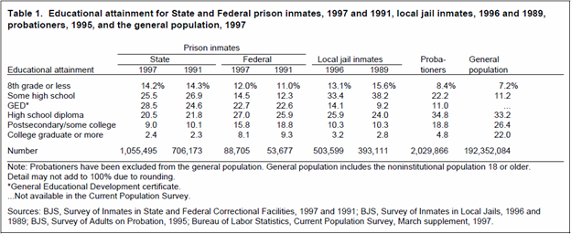
The Impact of Alternative Schools

Slide 22
The Impact of Alternative Schools
Nearly 1 of every 10 young male high school dropouts was institutionalized on a given day in 2006-2007
Source: Center for Labor Market Studies, Northeastern University

Slide 23
The Impact of Alternative Schools
The average Arizona high school dropout will cost taxpayers over $463,500 in lower tax revenues, and increased public and private expenses for health, crime, and welfare
Source: Arizona Mayors Education Roundtable

Slide 24
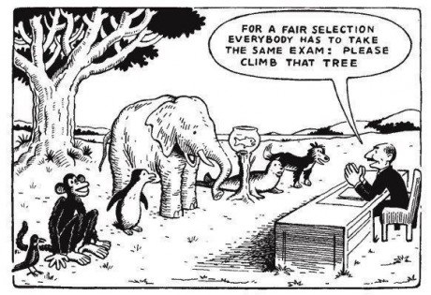
Alternative Schools and Accountability

Slide 25
Alternative Schools and Accountability
ESSA dictates that states must:

Slide 26
Alternative Schools and Accountability
ESSA dictates that states must:
Set long-term goals
Develop accountability systems aligned with those goals
Meaningfully differentiate between schools based upon those indicators for the purpose of continuous improvement

Slide 27
Alternative Schools and Accountability
How to avoid over-identification of alternative schools under ESSA?
6% percent of all high schools are alternative, 30% percent of identified schools are alternative
12% of all high schools would be identified, 60% of alternative schools would be identified
Source: 2017 Building a Grad Nation Report, http://gradnation.americaspromise.org/report/2017-building-grad-nation-report
Over-identification: bad schools or bad metrics?
American Youth Policy Forum; Deeds, 2017

Slide 28
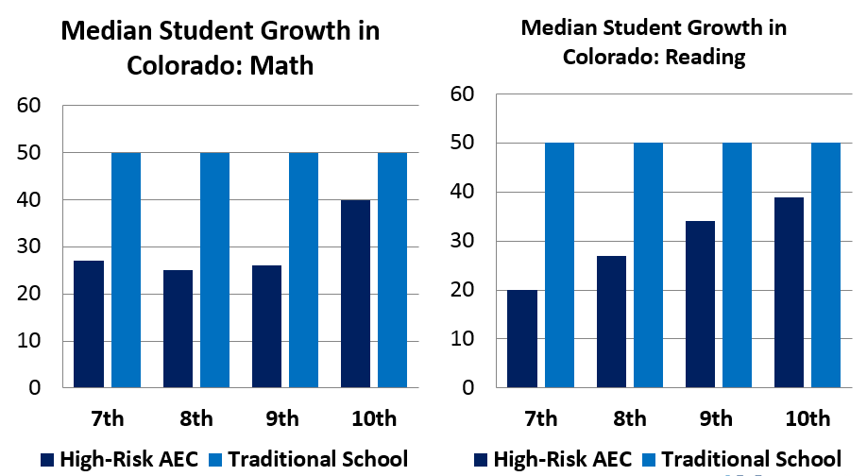
Jody Ernst, Ph.D. Momentum Strategy & Research

Slide 29
Every Student Succeeds: What does it mean to succeed and how much flexibility should we allow?
American Youth Policy Forum defines success as:
lifelong learner
family-sustaining wage
civically engaged
Does college and career readiness look the same for every student?

Slide 30
Arizona Alternative
Accountability Model
Can you have both rigor and flexibility?

Slide 31
Arizona Alternative
Accountability Model
Can you have both rigor and flexibility? YES!!
Alternative pathway, same result
Rigor and flexibility are not in conflict
Sufficiently nuanced approaches reflective of progress in alternative settings to ensure those settings are meeting their goals
Carinne Deeds, American Policy Youth Forum

Slide 32
Arizona Alternative
Accountability Model
According to Arizona Revised Statute 15-241.H., “… the department of education shall use achievement profiles to appropriately assess the educational impact of accommodation schools and alternative schools”.

Slide 33
Essential Elements of Effective Alternative Accountability
Policy Features
Clearly define schools as those serving only the most exceptional students;
Clear, specific process for applying with roles and responsibilities outlined; and
Inclusion of all school types.
Calls for separate accountability system that includes the use of alternative measures, and…
Framework Features
Allows schools to select measures that align with mission;
Focuses on individual student growth (both academic and non-academic);
Specifies the use of data from comparable students and/or schools for setting benchmarks and targets for success; and
Requires periodic review of the system to ensure rigor and relevance.
Momentum Strategy and Research

Slide 34
Arizona’s Traditional /Alternative Accountability Models
Traditional 9-12 School Accountability Model
Proficiency 30%
Growth 20%
ELL 10%
Graduation Rate 20%
College and Career Readiness 20%
Proposed Alternative High School Accountability Model
Proficiency 15%
Growth 20%
ELL 10%
Graduation Rate 20%
College and Career Readiness 35%
Schlessman, 2017

Slide 35
Proposed Graduation Rate
Students on track to graduate within 3 credit (by January 15) of SBE established requirement and graduate by June 30
Best of 4th, 5th, 6 or 7-year cohort-based graduation rate
1% of greater increase of overall (4-7 year inclusive) graduation rate year over year, until the school meets or exceeds the state alternative high school baseline average at which point, the school maintains the state average graduation rate

Slide 36
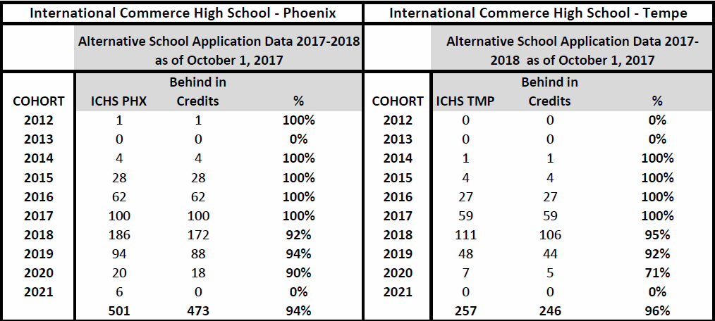
Real World Example of Grad Rate Challenges

Slide 37
Good framework focuses on individual student growth (both academic and non-academic)...
Academic Persistence (10%)….Continued enrollment at any public school in AZ by October 1 in current year from the prior year
+
Credits Earned (10%)...Students enrolled by October 1 who earn > 4.5 credits by the end of the school year, June 30
= GROWTH

Slide 38
Does college and career readiness look the same for every student?
Coursework in Work Study, Workplace Readiness, Career Readiness, Service Learning, Second Language
Accelerated Credit Recovery
Recipient of Competitive Scholarship to Post-Secondary Institution
Letters of Support/Position Statements from
National Dropout Prevention Center
Momentum Strategy and Research
National Alternative Education Association
TESOL International
Schlessman 2017

Slide 39
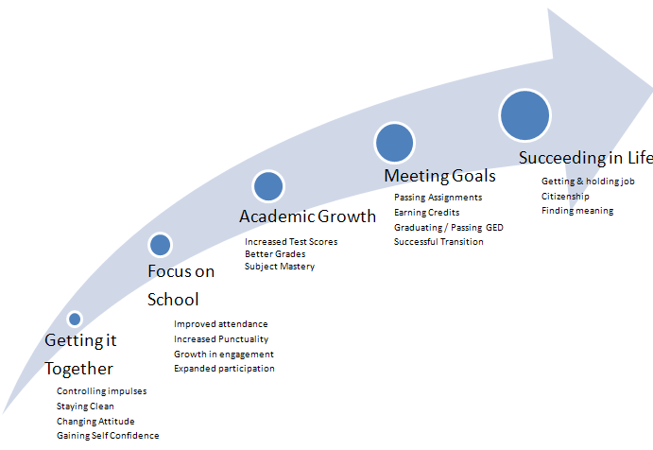
Growing Toward Success
* Diaz, Diaz, and Dixon as adapted by the Az Alternative Education Consortium

Slide 40
Questions?

Slide 41
Sources
Alternative Accountability Forum November, 2017 Presentation:Trends and Opportunities in Alternative Education Under ESSA
Deeds, Carinne. American Policy Youth Forum https://onedrive.live.com/view.aspx?resid=F77567DD880D628E!216&ithint=file%2cpptx&app=PowerPoint&authkey=!AF8c9QgKL6O8Byo
Ernst, Jody. Momentum Strategy & Research https://onedrive.live.com/view.aspx?resid=F77567DD880D628E!217&ithint=file%2cpptx&app=PowerPoint&authkey=!AFrDX2AYUy-FXUk
Schlessman, Amy. Research, Development and Innovation, Rose Academy https://onedrive.live.com/view.aspx?resid=F77567DD880D628E!218&ithint=file%2cpptx&app=PowerPoint&authkey=!AGqGB3JPJ0d8ifU
Arizona Revised Statute 15-241.H. https://azleg.gov/ars/15/00241.htm
Arizona Department of Education. Guide to Alternative School Status Application & Verification Process
Colorado Revised Statutes 22-7-6045 http://codes.findlaw.com/co/title-22-education/co-rev-st-sect-22-7-604-5.html
Texas At-Risk Educator Code http://ritter.tea.state.tx.us/peims/standards/1314/e0919.html

